Slide 1
Smithfield vs. Tyson 4Q 2025*
3/2/2026
(*) From Tyson’s Q1 2026 Report for the quarterly period ended December 27, 2025

Slide 2
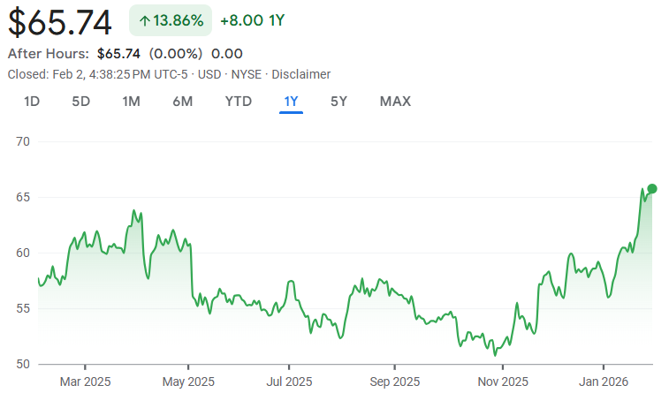
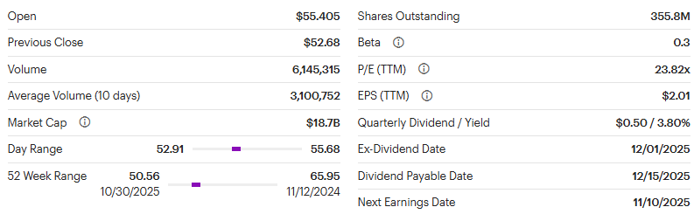
Tyson’s Q4 Earnings Release
Persistent Beef weakness and a reporting change overshadow a minor top and bottom-line beat.
Tyson’s stock closed up +0.6% driven by a minor sales, adjusting operating profit, and EPS beat. However, results were down from the prior year driven by continued weakness in Tyson’s Beef segment. Despite the strong results, Tyson changed their reporting methodology this quarter, which attracted scrutiny on their earnings call.
With the change, Tyson is breaking out corporate and amortization expense which used to be allocated to the segments – making analysts modelling and previous guidance incomparable to posted results. Analysts dialed in on the rationale for the change and its impact incentive structures. Further, analysts wanted to understand more about how the change impacts guidance.
4Q ’25 Tyson’s sales of $14.5B¹ were up +6.2% YoY, and adjusted operating income decreased -13% YoY to $572MM.
QTR Segment Adjusted Operating Income and YoY % change
Pork: $111MM, +52%
Prepared Foods: $338MM, +5%
Beef: -$143MM, ->200%
Chicken: $459MM, -3%
Tyson has provided new guidance in accordance with their methodology change. However, total 2026 adjusted operating income guidance remains at $2.1B-$2.3B, segments are as follows:
Pork SP: $250MM-$350MM
Prepared Foods SP: $1,250MM-$1,350M
Beef SP: ($500MM)-($250MM)
Chicken SP: $1,650MM-$1,900MM
International SP: $150MM - $200MM
Corporate and Amortization: ($950MM) – ($975MM)
Tyson Earnings Releases
Earnings Presentation
10-Q
Earnings Release
Tyson Foods Inc – 1 Year Earnings Overview
1: Tyson’s revenue has been adjusted for $150MM in legal charges.

Slide 3
Tyson – Sell Side Analyst Questions and Responses¹
The lack of specific questions on Tyson’s Pork segment likely signifies that analysts were satisfied with the prepared remarks and the segments profit trajectory.
Ben Theurer, Barclays: You’ve raised prices significantly over last year while volumes stayed flat, yet margins remain pressured. Where are you in recovering input‑cost inflation—especially higher beef costs in Prepared Foods—and how much additional pricing is needed to return margins to more stable levels?
Donnie King, Tyson: Our multiyear strategy is working, with net sales up about 8%, driven in part by volume. The net sales increase results from improvements in channel mix and formula‑based pricing in foodservice, where higher raw‑material costs automatically flow through. Commodity costs were up $100 million this quarter, but pricing is now catching up, especially in foodservice. Beef and pork trim costs remain high, though other inputs are stabilizing. Prepared Foods is executing. We grew market share and volume, dollar, and unit share. Further, this is our fifth consecutive quarter of improvement.
Pooran Sharma, Stephens: Given past seasonal trends in the first half of the year and recent input‑cost pressures, should we expect the Prepared Foods business to perform more evenly throughout the year, or will the usual seasonal pattern continue?
Donnie King, Tyson: Last year we did point to a more balanced first‑half/second‑half performance due to operational improvements that temporarily shifted seasonality. We expect results to move back towards a more normal pattern, which is typically more weighted to the first half. However, some higher‑cost inventory from the prior quarter carried into Q1, which may neutralize some of the normal seasonality.
1: Tyson’s revenue has been adjusted for $343MM in legal charges.
1: Questions and responses have been edited for brevity.

Slide 4
Tyson Corporate Allocation Methodology
Prior to their change in methodology, Tyson used to allocate the most expense to their Prepared Foods and Chicken segments.
Over the last 15 years, Tyson has deployed over $17B in capital – primarily through 3 transformation acquisitions from 2014 to 2018.
Acquisition capital was mainly allocated to the Prepared Foods and Chicken Segments – likely impacting the amortization allocation to those segments.
Major Acquisitions:
Hillshire Brands ($8.6B): Allocated to Prepared Foods
AdvancePierre Foods ($4.2B): Allocated to Prepared Foods and Chicken
Keystone Foods ($2.2B): Allocated to Chicken and International

Slide 5
Tyson Adj. Quarterly Profit and Allocation Detail
Tyson allocated between $80-$90MM in expense to Prepared Foods while Pork was allocated between $15-$20MM.

Slide 6
Tyson Corporate Allocation Methodology¹
Despite the higher revenue base, Tyson’s corporate expense as a percentage of revenue is 0.5% higher than Smithfield’s in 2025.
In 2025, Tyson revenue was 3.6x greater than Smithfield revenue.
However, Tyson’s corporate expense, prior to the amortization, was 5.6x greater than Smithfield corporate expense.
Tyson’s more active acquisition history has also translated to amortization expense which is 26x greater than Smithfield.
1: Tyson results are adjusted to align with Smithfield’s fiscal period.

Slide 7
Tyson Amortization Summary¹
The majority of Tyson’s amortizable intangible assets are in Customer Relationships and Brands and Trademarks.
1: As of the end of Tyson’s fiscal 2025 and 2024.

Slide 8
US Pork vs. Tyson Pork Profit Trend^{1,2}
US Pork’s comparative performance vs Tyson’s Pork segment flipped after restating Tyson results for their new methodology. Without the change, US Pork would have outperformed Tyson’s Pork segment by $2.54/hd in 2025.
SFD vs TSN Operating Margin |  | 2023 |  |  |  |  | 2024 |  |  |  |  | 2025 |  |  |  |  | T8Q
 |  | Q1 | Q2 | Q3 | Q4 | FY | Q1 | Q2 | Q3 | Q4 | FY | Q1 | Q2 | Q3 | Q4 | FY
US Pork | SFD¹ | -10.1% | -12.6% | -3.4% | -4.3% | -7.6% | -3.1% | 0.3% | 3.3% | 3.0% | 0.9% | 3.4% | 2.2% | 4.1% | 6.6% | 4.0% | 2.6%
 | TSN Old (w/ Corp. Alloc.) | -2.2% | -5.3% | -0.5% | 4.5% | -0.7% | 2.2% | 1.5% | 1.3% | 3.6% | 2.2% | 3.7% | 2.4% | 2.0% | 5.8% | 3.5% | 2.9%
 | TSN New (w/o Corp. Alloc.) | -1.1% | -4.2% | 0.7% | 5.7% | 0.5% | 3.2% | 2.6% | 2.4% | 4.5% | 3.2% | 4.6% | 3.3% | 3.0% | 6.7% | 4.5% | 3.8%
Gap | vs TSN Old (w/ Corp. Alloc.) | -7.9% | -7.3% | -2.9% | -8.7% | -6.9% | -5.3% | -1.1% | 2.0% | -0.7% | -1.3% | -0.3% | -0.2% | 2.1% | 0.8% | 0.5% | -0.3%
 | vs TSN New (w/o Corp. Alloc.) | -9.0% | -8.4% | -4.2% | -9.9% | -8.1% | -6.3% | -2.2% | 0.9% | -1.6% | -2.3% | -1.2% | -1.1% | 1.0% | -0.1% | -0.4% | -1.3%
SFD vs TSN OP/HD |  | 2023 |  |  |  |  | 2024 |  |  |  |  | 2025 |  |  |  |  | T8Q
 |  | Q1 | Q2 | Q3 | Q4 | FY | Q1 | Q2 | Q3 | Q4 | FY | Q1 | Q2 | Q3 | Q4 | FY
US Pork | SFD¹ | -$28.87 | -$36.02 | -$10.36 | -$11.23 | -$21.63 | -$8.72 | $1.03 | $10.02 | $8.54 | $2.61 | $11.14 | $7.43 | $14.57 | $20.24 | $13.41 | $8.04
 | TSN Old (w/ Corp. Alloc.) | -$6.16 | -$14.62 | -$1.69 | $12.84 | -$2.07 | $6.38 | $4.60 | $3.96 | $11.19 | $6.64 | $11.11 | $7.43 | $6.24 | $18.14 | $10.88 | $8.76
 | TSN New (w/o Corp. Alloc.) | -$2.98 | -$11.49 | $2.33 | $16.24 | $1.36 | $9.28 | $8.15 | $7.29 | $13.84 | $9.10 | $13.94 | $10.32 | $9.46 | $20.86 | $13.79 | $11.77
Gap | vs TSN Old (w/ Corp. Alloc.) | -$22.72 | -$21.40 | -$8.67 | -$24.07 | -$19.56 | -$15.10 | -$3.57 | $6.06 | -$2.64 | -$4.03 | $0.03 | $0.01 | $8.33 | $2.11 | $2.54 | -$0.72
 | vs TSN New (w/o Corp. Alloc.) | -$25.89 | -$24.54 | -$12.69 | -$27.47 | -$22.99 | -$17.99 | -$7.12 | $2.73 | -$5.30 | -$6.49 | -$2.80 | -$2.88 | $5.11 | -$0.62 | -$0.38 | -$3.72
1: Smithfield results are adjusted segment profit, which exclude the favorability from the ERC, and is in-line with Non-GAAP results for external reporting. For US Pork, if the ERC was included, segment margins would be 2.4% ($8.2/HD) and 2.7% ($8.1/HD) in Q225 and Q224, respectively.
2: Tyson’s Pork results exclude the impact of an antitrust legal charges in Q224, Q125, Q325, and Q425.

Slide 9
Packaged Meats vs. Tyson Prepared Foods Profit Trend¹
After adjusting for Tyson’s new methodology, US Packaged Meats outperformed Tyson in 7 of the last 12 quarters as opposed to outperforming in all quarters prior to the change.
SFD vs TSN Operating Margin |  | 2023 |  |  |  |  | 2024 |  |  |  |  | 2025 |  |  |  |  | T8Q
 |  | Q1 | Q2 | Q3 | Q4 | FY | Q1 | Q2 | Q3 | Q4 | FY | Q1 | Q2 | Q3 | Q4 | FY
US Packaged Meats | SFD¹ | 14.5% | 14.7% | 9.5% | 12.7% | 12.9% | 14.3% | 15.0% | 12.5% | 12.6% | 13.5% | 13.1% | 14.2% | 10.8% | 11.8% | 12.4% | 13.0%
 | TSN Old (w/ Corp. Alloc.) | 10.4% | 9.2% | 6.0% | 10.4% | 9.0% | 9.7% | 8.3% | 8.3% | 9.5% | 8.9% | 10.2% | 9.8% | 7.4% | 9.4% | 9.2% | 9.1%
 | TSN New (w/o Corp. Alloc.) | 13.9% | 12.7% | 9.5% | 13.9% | 12.5% | 13.4% | 11.9% | 11.4% | 13.0% | 12.4% | 13.7% | 13.3% | 10.9% | 12.6% | 12.6% | 12.5%
Gap | vs TSN Old (w/ Corp. Alloc.) | 4.1% | 5.5% | 3.5% | 2.3% | 3.9% | 4.6% | 6.7% | 4.2% | 3.1% | 4.6% | 2.9% | 4.5% | 3.4% | 2.3% | 3.2% | 3.9%
 | vs TSN New (w/o Corp. Alloc.) | 0.6% | 2.0% | 0.0% | -1.2% | 0.4% | 0.8% | 3.1% | 1.0% | -0.5% | 1.1% | -0.6% | 1.0% | -0.1% | -0.9% | -0.2% | 0.4%
SFD vs TSN OP/cwt |  | 2023 |  |  |  |  | 2024 |  |  |  |  | 2025 |  |  |  |  | T8Q
 |  | Q1 | Q2 | Q3 | Q4 | FY | Q1 | Q2 | Q3 | Q4 | FY | Q1 | Q2 | Q3 | Q4 | FY
US Packaged Meats | SFD¹ | $40.83 | $41.97 | $28.80 | $35.06 | $36.71 | $40.25 | $45.86 | $38.31 | $35.90 | $39.76 | $39.07 | $44.54 | $36.17 | $35.33 | $32.48 | $39.18
 | TSN Old (w/ Corp. Alloc.) | $30.48 | $26.38 | $17.59 | $29.55 | $25.99 | $27.99 | $23.86 | $24.22 | $27.06 | $25.78 | $30.09 | $29.59 | $22.39 | $29.14 | $27.79 | $26.77
 | TSN New (w/o Corp. Alloc.) | $40.64 | $36.33 | $27.72 | $39.51 | $36.04 | $38.80 | $33.97 | $33.43 | $37.23 | $35.85 | $40.58 | $40.18 | $32.94 | $39.01 | $38.15 | $36.99
Gap | vs TSN Old (w/ Corp. Alloc.) | $10.34 | $15.59 | $11.21 | $5.51 | $10.72 | $12.27 | $22.00 | $14.09 | $8.84 | $13.99 | $8.98 | $14.94 | $13.78 | $6.19 | $4.69 | $12.40
 | vs TSN New (w/o Corp. Alloc.) | $0.18 | $5.64 | $1.08 | -$4.45 | $0.67 | $1.45 | $11.89 | $4.88 | -$1.33 | $3.91 | -$1.50 | $4.36 | $3.23 | -$3.67 | -$5.67 | $2.18
1: Smithfield results are adjusted segment profit, which exclude the favorability from the ERC, and is in-line with Non-GAAP results for external reporting. If included, US Packaged Meats margins would be 14.5% ($45.3/cwt) and 17.0% ($51.9/cwt), respectively.

